Slide 1
Charting your course
When Ivy is your destination….

Slide 2
The game: Science or art?
Objective
Know the game
Is an Ivy accepted application a recipe or a canvas?
Metaphorically speaking…Do admissions officers prefer baked goods are art appreciation gifts?
What is best for my child to flourish?

Slide 3
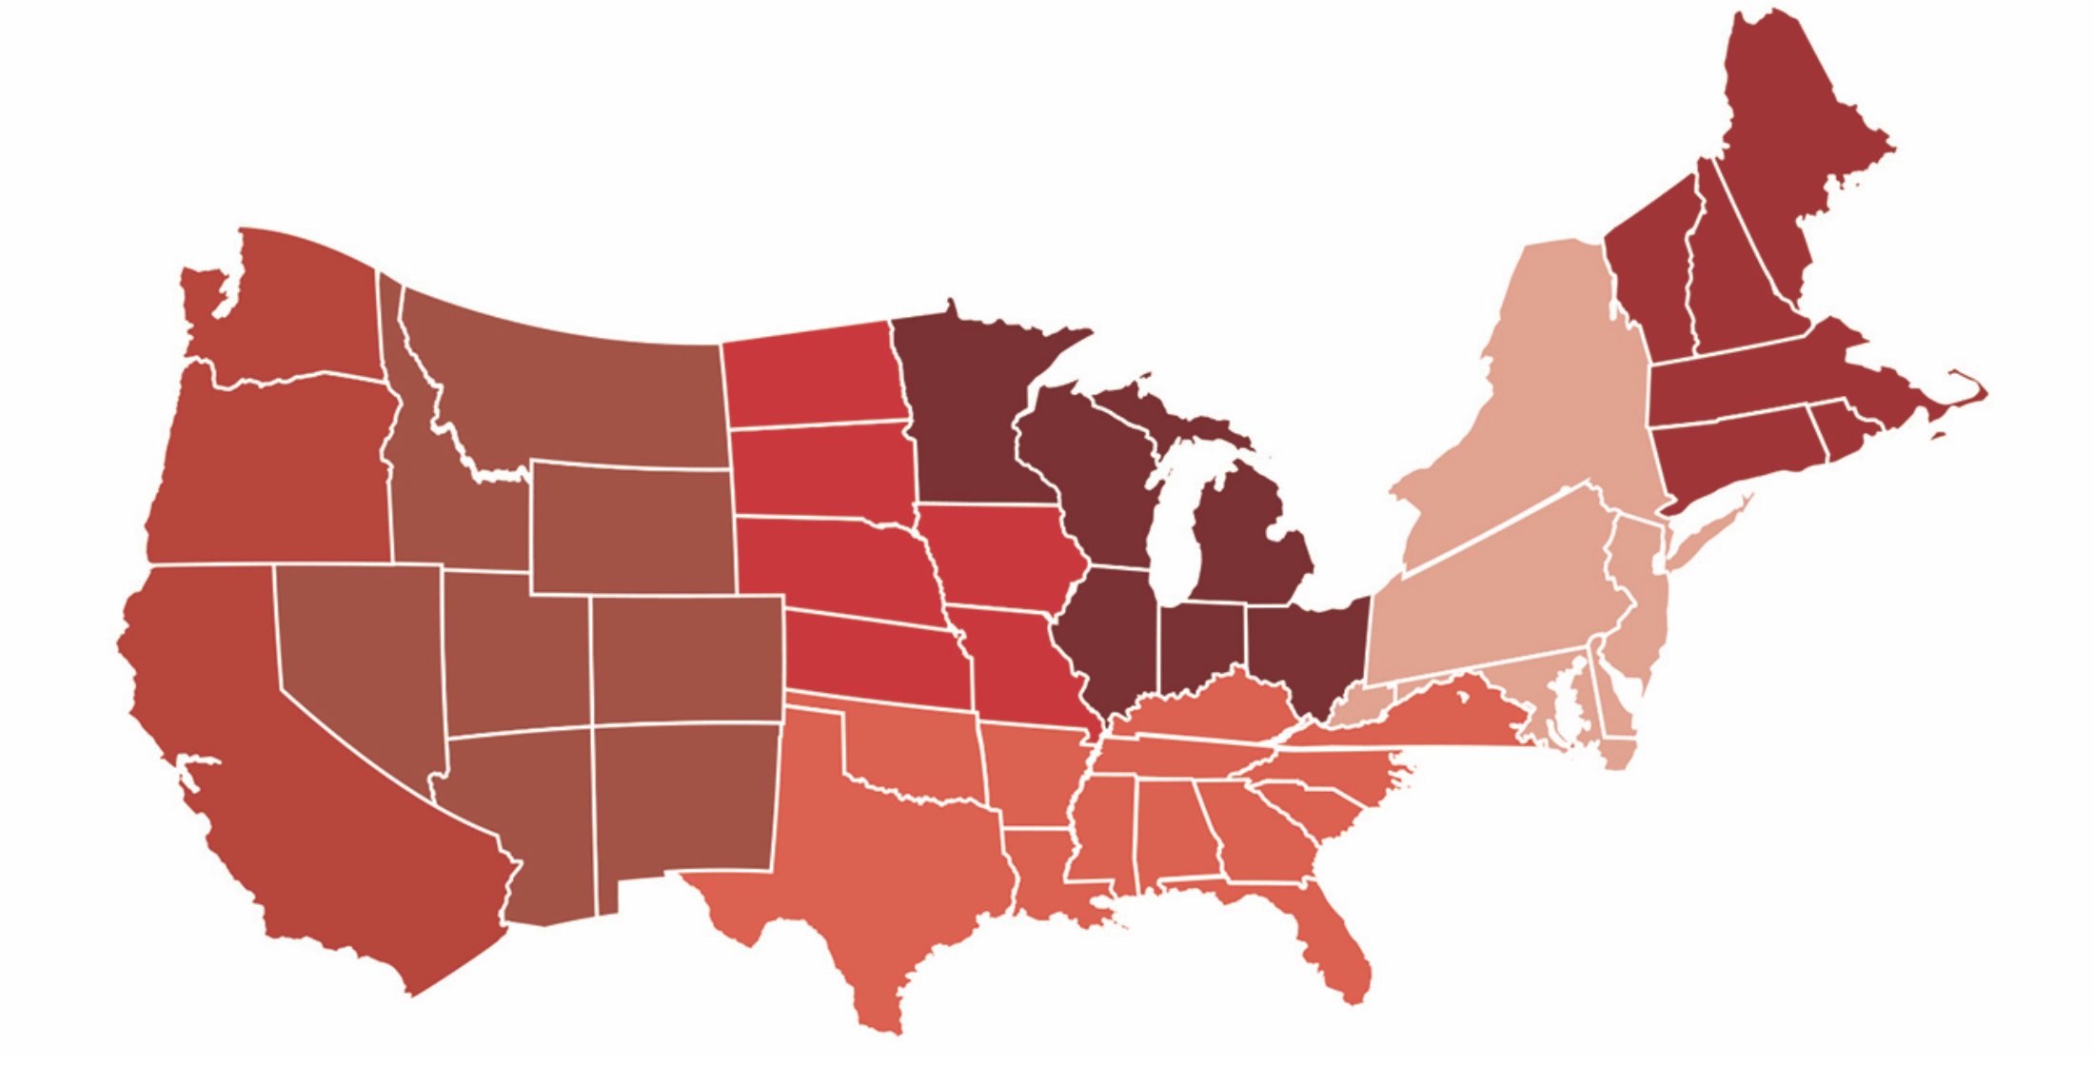
The current mission of ivy?
“It isn’t hard to graduate from Harvard. The work is not harder.”
David Evans, Sr. Admissions Officer at Harvard

Slide 4
Demographics & the future
HARVARD (example for time sake)
39,041 applications
2106 admits
Admit a freshman class that looks like leaders of the future

Slide 5
leaders that represent whom they lead

Slide 6
How to stand out

Slide 7
“If the applicant lost this one thing, would they still be a good admit?”
Janet Rapelye, Dean of Admissions at Princeton
“Is this student the next great _________ of their generation?”
William Fitzsimmons, Dean of Admissions at Harvard
“We denied six students last year with a perfect ACT score.”
David Evans, Sr. Admissions Officer at Harvard

Slide 8
The science
Student
Academics
5 subjects per term
4 years of language
Essay
Think about your audience
Content + Structure/Spelling

Slide 9
The art
Extra-curriculars
* Not what, but why
* Evidence of leadership
* Balance with other activities
* Volunteering
* Like unique “off the wall”
Communicated Motivation
* Consistency in interest (communicated)
* Why you for the slot
* Irreplaceably unique
Demonstrated Interest

Slide 10
The parenting…
Elementary
Areas of interest, growth mindset, places of purpose and value
Middle
Community, academic endurance/practice, organization/time management, places of purpose and value
High
Time management, realistic goals, college visits, summer camps, pursuit of passion and purpose

Slide 11
Final thoughts
Princeton: 2 Ivy’s, 2 Reach, 2 Safe
Book: 40 Colleges that Changes Lives, Loren Pope

